Slide 1

RNS INSTITUTE OF TECHNOLOGY
BENGALURU - 98
DEPARTMENT OF INFORMATION SCIENCE & ENGINEERING
Presentation on Internship
Predict The Price Of Books
Lakshmi Sarvani B
USN: 1RN19IS402
LocalHost Technology Private Limited
Internal Guide
Mr.. Karthik S Chouri
Asst. Prof, Dept of ISE, RNSIT
External Guide
Mr. Satyendra Nath
Data Scientist, LocalHost Tecnology
Notes:
12

Slide 2
AGENDA
Abstract
About the Company
Introduction
Literature Survey
Requirements
System Design
Detailed Design
Implementation
Testing
Conclusion and Future Enhancements
References
Q & A
VII Semester, Department of ISE, RNSIT
2021 - 2022
12

Slide 3
ABSTRACT
Python
SQL
Data Science Models
Linear Regression
Logistic Regression
VII Semester, Department of ISE, RNSIT
2021 - 2022
12

Slide 4
About the Company
NoC is the main interconnecting infrastructure in CMP(chip multi processor) and many-core systems which are composed of routers that are inter-connected to provide the processing elements.
The major challenges in the fabrication process of NoC designs is occurrence of defective components where routers and links are the major components of NoC.
These components may be subjected to manufacturing defect or sometimes due to exposing to different noises, radiation, and interferences.
VII Semester, Department of ISE, RNSIT
2021 - 2022
12

Slide 5
INTRODUCTION
In this project we use the given data set to predict the price of books based on certain features like:
Author: The author(s) of the book.
Edition: The edition of the book
Reviews: The customer reviews about the book
Ratings: The customer ratings of the book
Genre: The genre the book belongs to
VII Semester, Department of ISE, RNSIT
2021 - 2022
12

Slide 6
LITERATURE SURVEY
MACHINE LEARNING BASED TECHNIQUES IN MEDICAL DATA ANALYSIS
Online Book Store
Stock Market Prediction
VII Semester, Department of ISE, RNSIT
2021 - 2022
12

Slide 7
Requirements
Anaconda Navigator
Jupyter Notebook
Data Set
OS: Windows 10
RAM: 1GB
VII Semester, Department of ISE, RNSIT
2021 - 2022
12

Slide 8
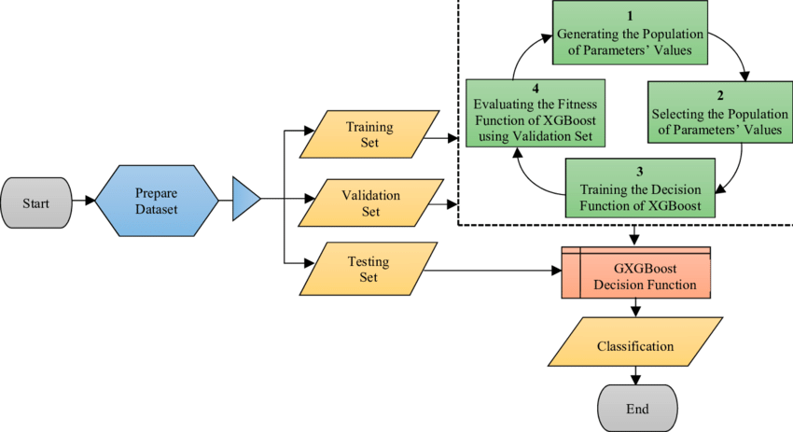
System Design
VII Semester, Department of ISE, RNSIT
2021 - 2022
12
Notes:
12

Slide 9
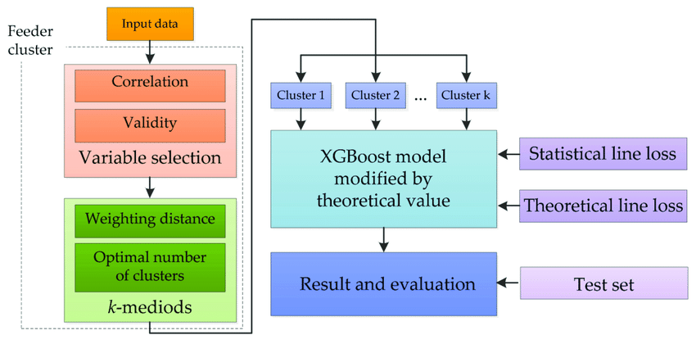
Detailed Design
VII Semester, Department of ISE, RNSIT
2021 - 2022
12
Notes:
12

Slide 10
CONCLUSIONS
XGBoost is an optimized distributed gradient boosting library designed to be highly efficient, flexible and portable.
VII Semester, Department of ISE, RNSIT
2021 - 2022
12
Notes:
12

Slide 11
Future Enhancements
We can further increase the efficiency of the algorithm.
Improve the accuracy of prediction.
Try to decrease the execution time.
VII Semester, Department of ISE, RNSIT
2021 - 2022
12
Notes:
12

Slide 12
REFERENCES
[1]https://machinehack.com/hackathon/predict_the_price_of_books/data
[2]https://medium.com/analytics-vidhya/books-price-prediction-via-python-31dc358ad8d8
[3]https://www.sciencedirect.com/science/article/abs/pii/S1568494620303410.
[4]https://www.researchgate.net/publication/336992097_LITERATURE_SURVEY_ON_MACHINE_LEARNING_BASED_TECHNIQUES_IN_MEDICAL_DATAANALYSIS
VIII Semester, Department of ISE, RNSIT
2021 - 2022
12

Slide 13
THANK YOU
VIII Semester, Department of ISE, RNSIT
2021 - 2022
12

